Slide 1
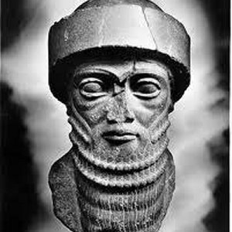
Topic: The Babylonian Empire
EQ: How did Hammurabi control his huge empire?
Notes:
Cornell Notes

Slide 2
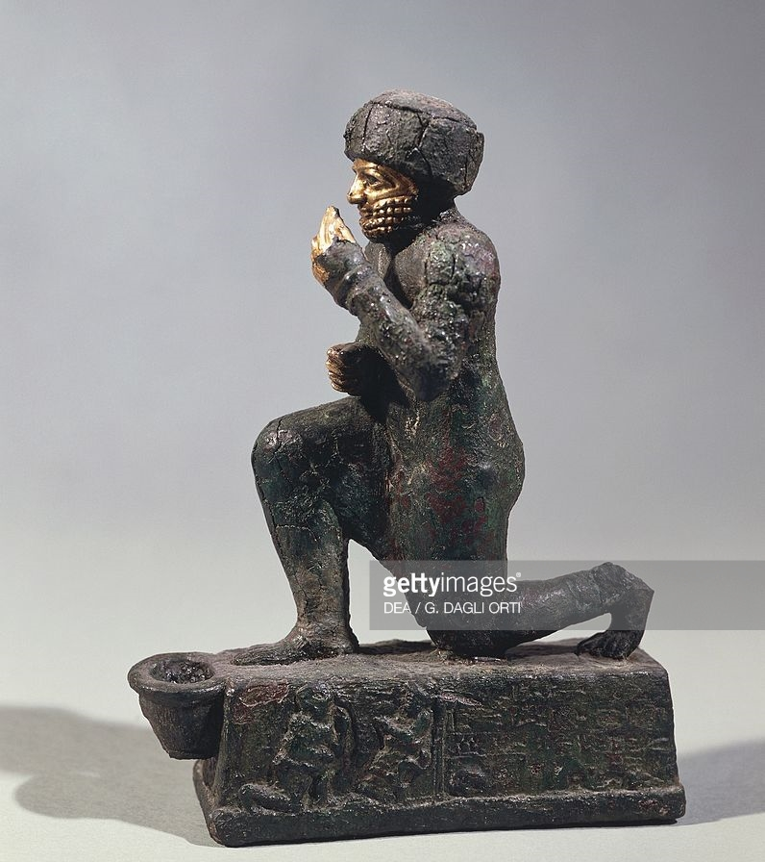
What do you notice?
What do you wonder?

Slide 3
Notes:
Amorites invaded Sumer about 2000 B.C., chose Babylon as their capital.
Hammurabi—powerful Amorite king who ruled from 1792 to 1750 B.C. - extended empire across Mesopotamia, Fertile Crescent - appointed governors, tax collectors, judges to control lands - watched over agriculture, trade, and construction.

Slide 4
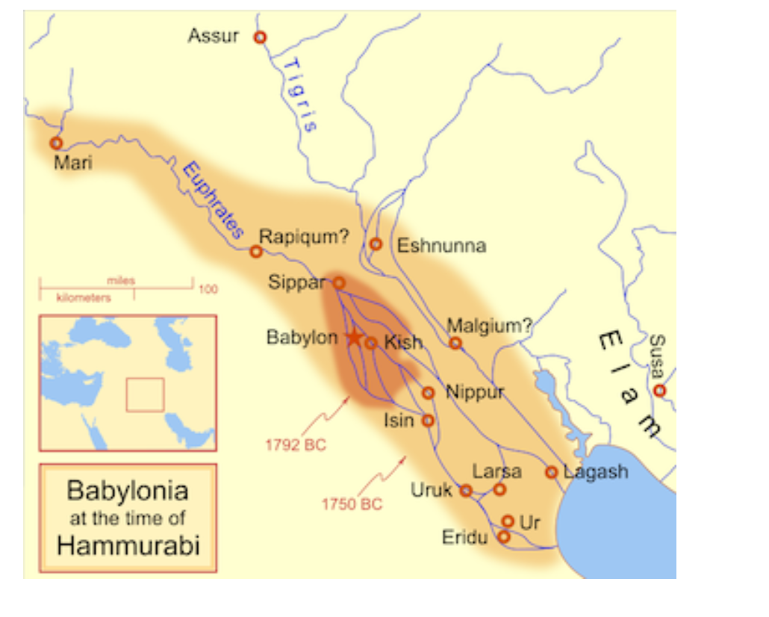
How do you think Hammurabi manage to keep his empire in working order?

Slide 5
Notes:
Hammurabi wanted code of law to control vast empire of many peoples - code of law—set of written rules for people to obey
- studied set of existing rules, combined them into single code of law.

Slide 8
Justice—fair treatment of people.

Slide 9
Notes:
Justice for All - Code’s goal was to bring justice—fair treatment of people
- listed illegal acts, had different punishments for each social class
- gave rights to land owners, including women and children.
Notes:
Add Question on left hand side: How do you think Sargon manage to keep his empire in working order?
Close Cornell Notes with two questions and a summary.

Slide 10
Notes:
Code formed idea that government should provide, justice
-Hammurabi wanted to end personal revenge as a way to solve problems.
Spread idea that society should be run by rule of law
-law is applied to all people not just a few.
Code was written in cuneiform, displayed on pillars near temple - suggests everyone has a right to know laws and punishments.
Notes:
Add Question on left hand side: How do you think Sargon manage to keep his empire in working order?
Close Cornell Notes with two questions and a summary.

Slide 11
The Law Code Stele of King Hammurabi

