Slide 1
Topic: Mesopotamian Empires
EQ: Who Controlled Mesopotamia?
Notes:
Cornell Notes

Slide 3
Empire—many different peoples, lands controlled by one ruler (emperor)

Slide 4
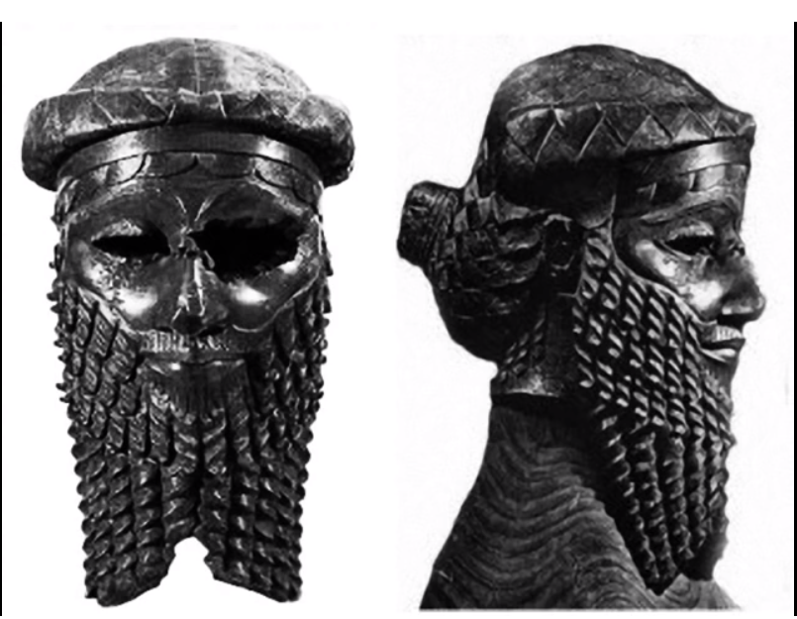
Sargon the Great
The Creator of the World’s First Empire.
What can we learn about Sargon by looking at this image?
What are three questions you might have?

Slide 5
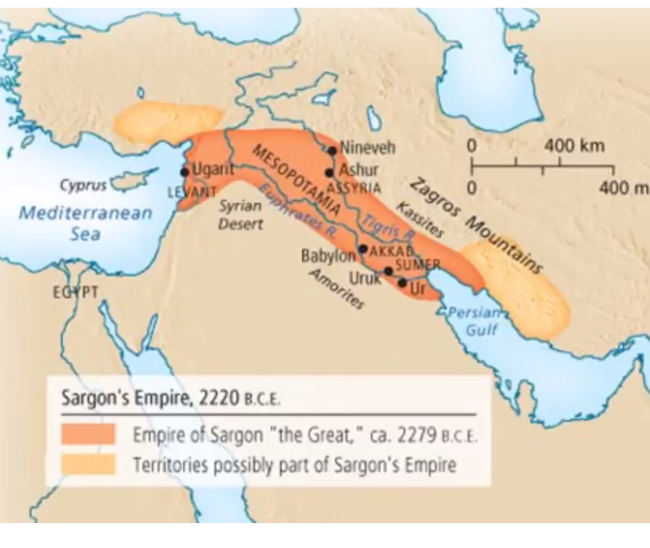
How do you think Sargon manage to keep his empire in working order?

Slide 6
Notes:
Sumerian city-state kings fought over land from 3000 to 2000 B.C.
Sargon of Akkad was a powerful leader, creator of the world’s first empire - he took over northern and southern Mesopotamia around 2350 B.C.

Slide 7
Notes:
his conquests of many different peoples led to cultural diffusion-the spread of ideas across cultures
One of the ideas was the Akkadian system of writing.

Slide 8
Notes:
By placing his most trusted men as governors and administrators
By keeping a permanent army to keep empire stable
By building roads, improving irrigation, expanding trade, creating a tax system that was fair for all social classes
Notes:
Add Question on left hand side: How do you think Sargon manage to keep his empire in working order?
Close Cornell Notes with two questions and a summary.

Slide 9
The Akkadian Period (ca. 2350–2150 B.C.)
Sargon ruled for 56 years, he died of natural causes. His sons ruled. His grandson expanded empire. Unfortunately, continuous revolts led to the fall of the Akkadian empire.
Notes:
Closing slide -- not part of the Cornell Notes.

Slide 10
